Slide 1


Flight delay analysis
Team:
AMULYA POTLURI
NAVEEN REDDY GARLAPATI
PARDHASARADHI GOLAMARU

Slide 2
PROBLEM STATEMENT
Flights being the most preferable mode of transport because of its speed and comfort. Though millions of people travel on daily basis. there are few obstacles like flight cancellations and delays which may create discomfort in their journey. Moving Further, we will be analyzing the flight data in terms of delays, cancellations and preferred carriers. Besides that, we will be looking some visualizations followed by a prediction model helping with the best airline to travel.

Slide 3
IMPLEMENTATION
Data Sourcing
Data Cleaning
Applied EDA Techniques
Feature Selection
Writing the clean data to MongoDB collection.
Connecting mongo DB to Tableau
Visualizing using Pyspark and in Tableau
Model building

Slide 4
What is not implemented
Instead of using mongo spark connector we have read the data from google drive and loaded the cleaned data to Mongo DB.
We have analyzed 5 years data instead of 10 years of data.

Slide 5
ABOUT DATA
We have taken the dataset from Harvard Dataverse. Here, is the link for the new dataset.
Link:https://dataverse.harvard.edu/dataset.xhtml?persistentId=doi:10.7910/DVN/HG7NV7
The Dataset consists of data from 1997 to 2008.
It has 29 columns and different delays like Arrival Time Delay, Departure Time Delay, Weather Delay, NAS Delay, Carrier Delay, Security Delay and Late Aircraft Delay.
It has 1491 carriers and 3376 airports.

Slide 6
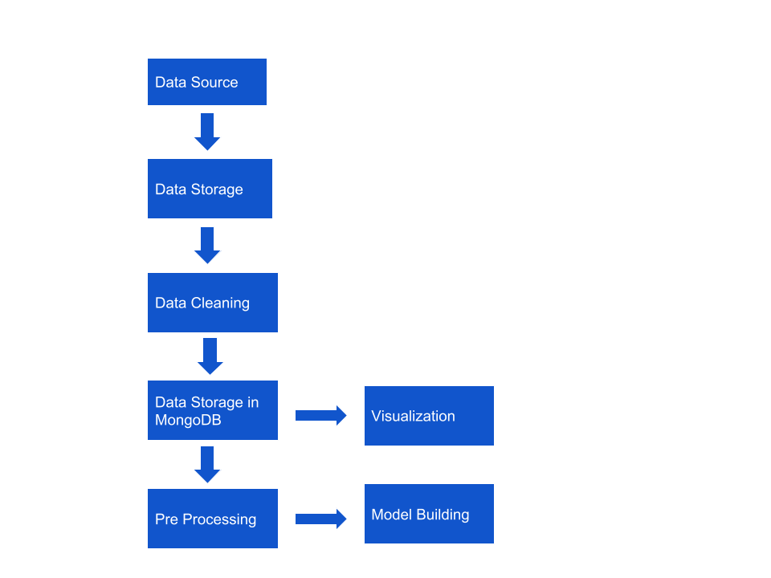



Architecture

Slide 7
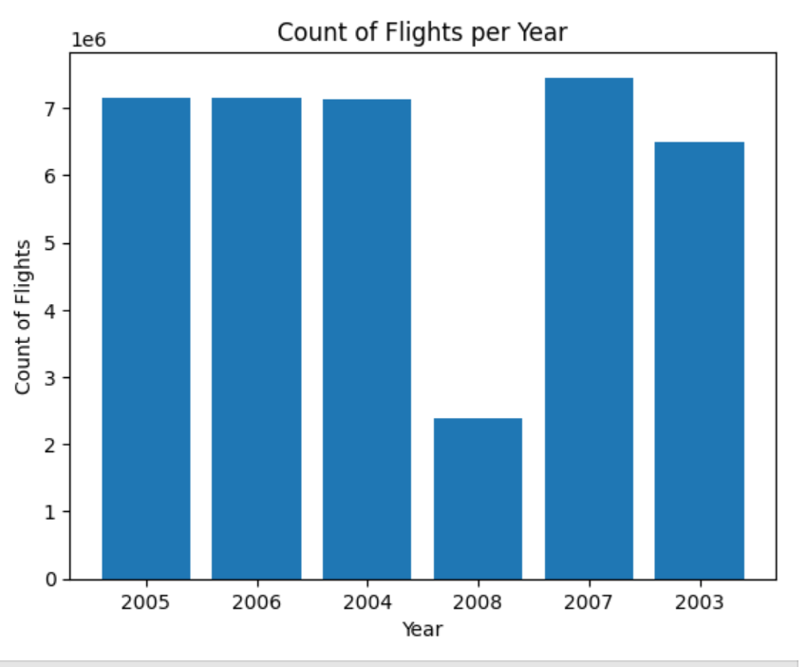
Exploratory Data Analysis
We have plotted a graph to check the flight count on yearly basis.

Slide 8
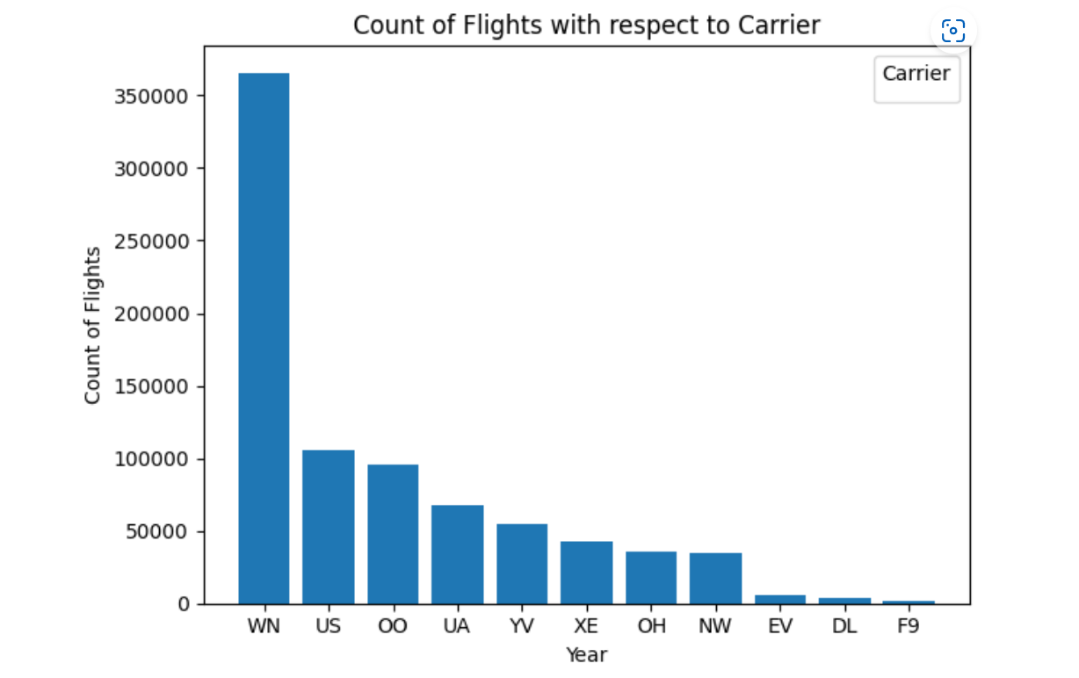
Exploratory Data Analysis
We have plotted a graph most preferred top 15 carriers from 2003 to 2008
We have observed that the WN carrier is most preferred.

Slide 9
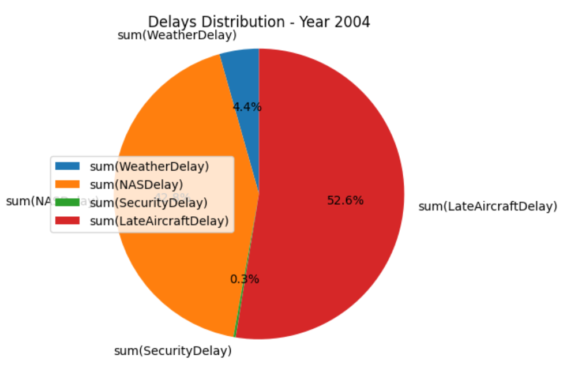
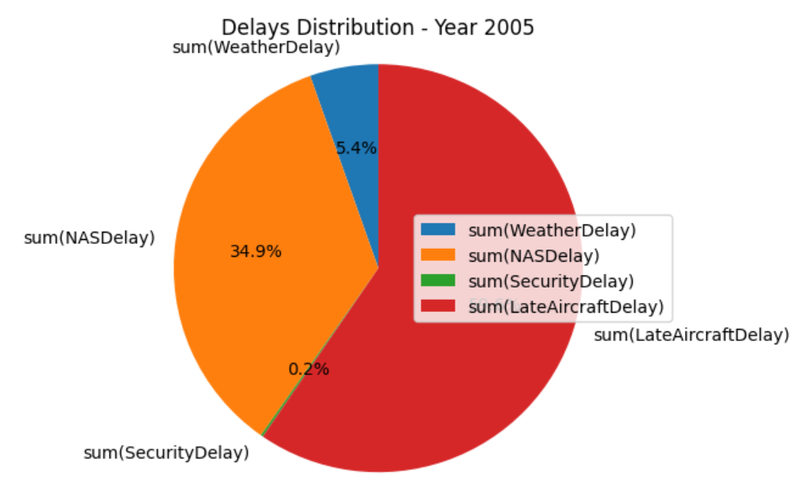
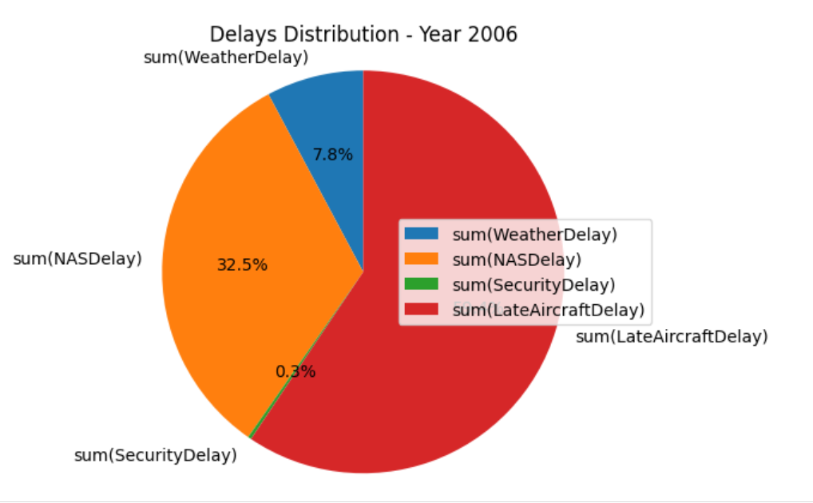
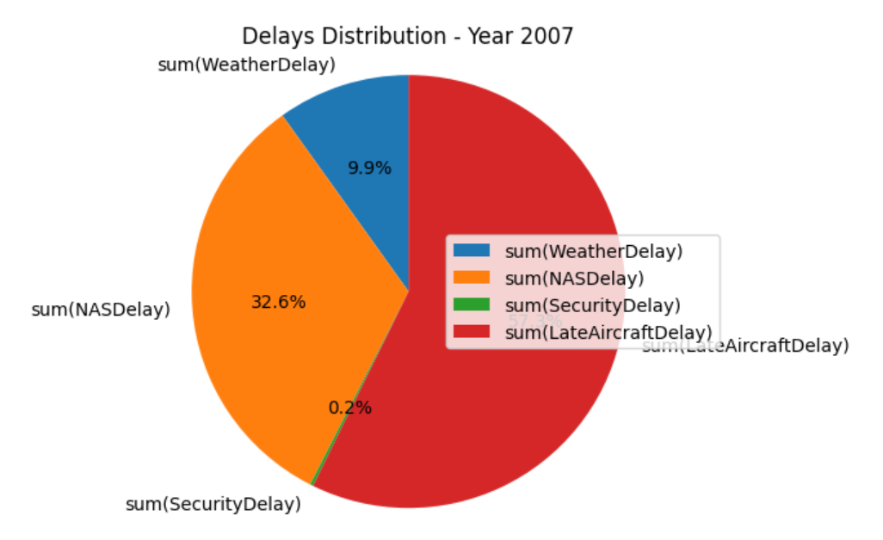
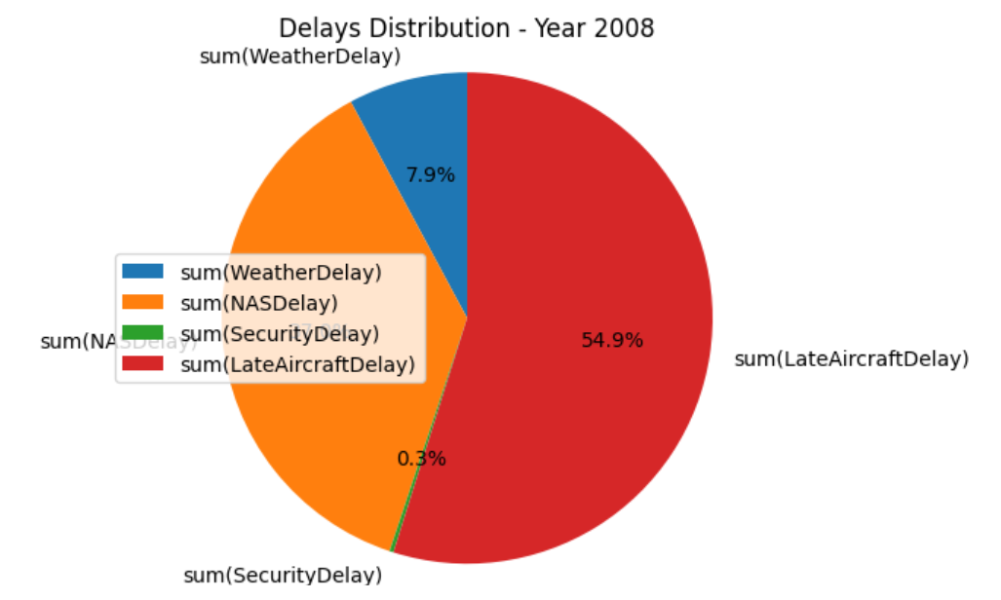
Exploratory Data Analysis
Majority of the delays from 2004 to 2008 occurred are due to LateAircraftDelay
Security delays are observed at the least.

Slide 10
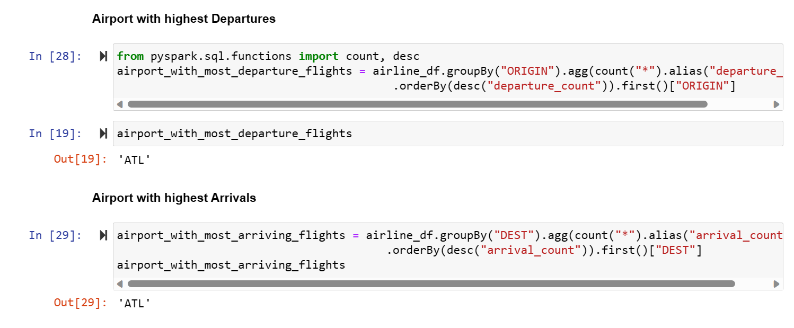
Airports with highest Arrivals and Departures

Slide 11
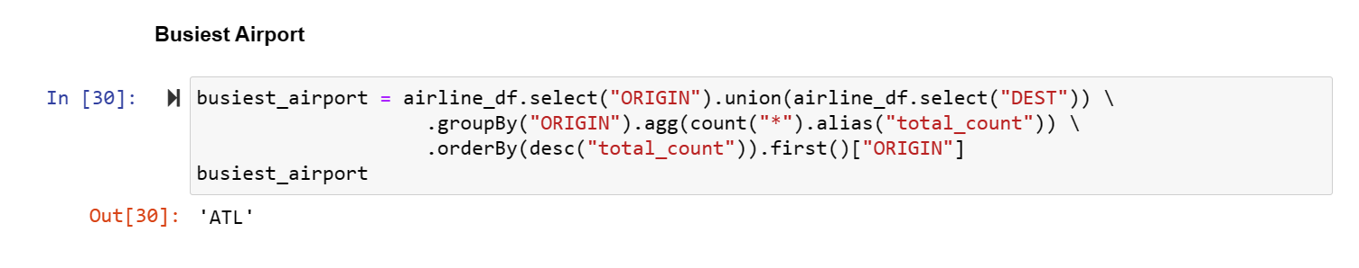
Busiest Airport

Slide 12
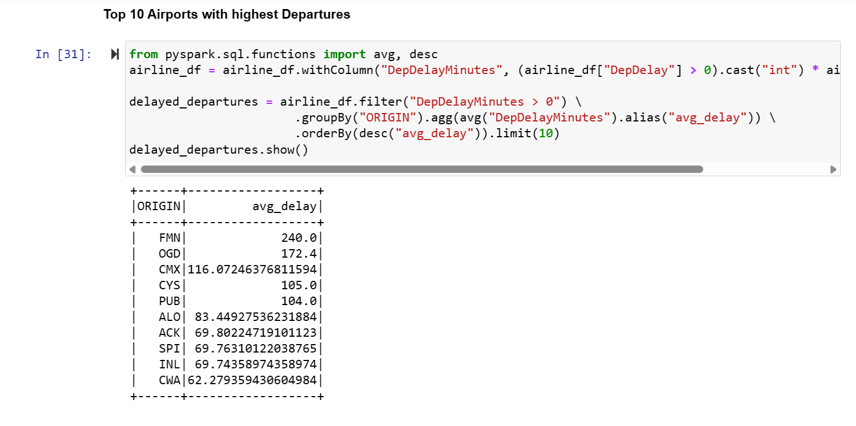
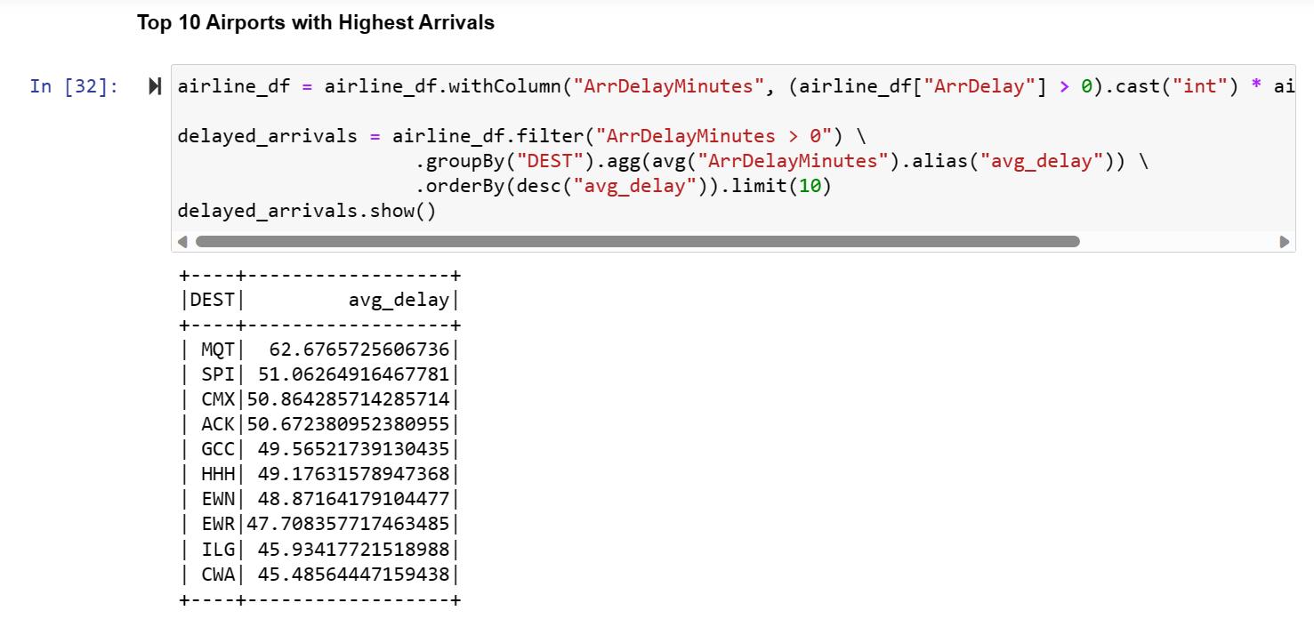
Top 10 Airports with highest average Arrival and Departure delays

Slide 13
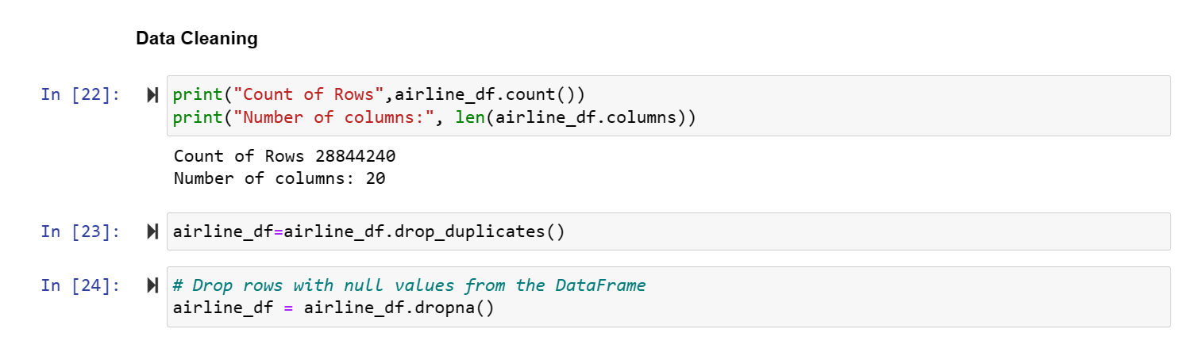
Data cleaning

Slide 14
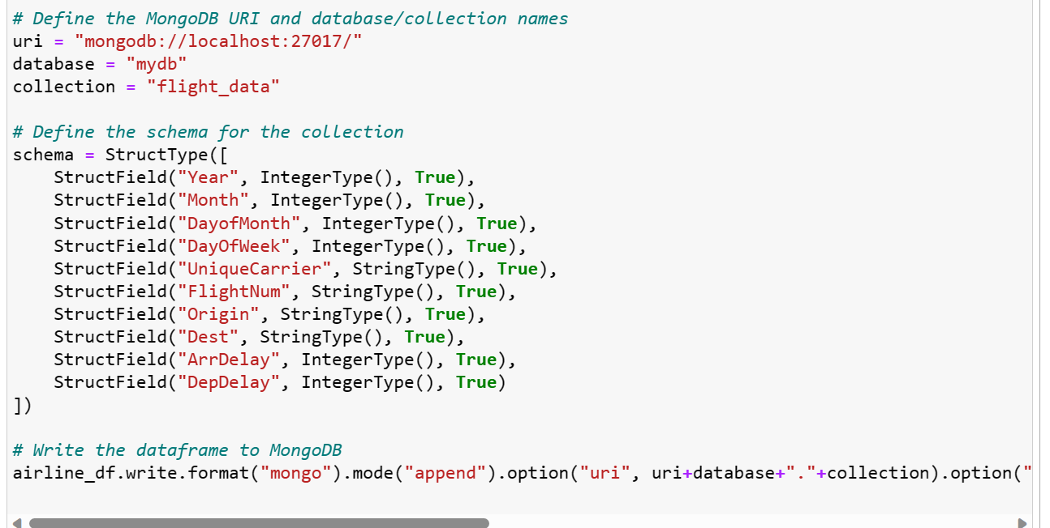
Data Loading into Mongo DB

Slide 15
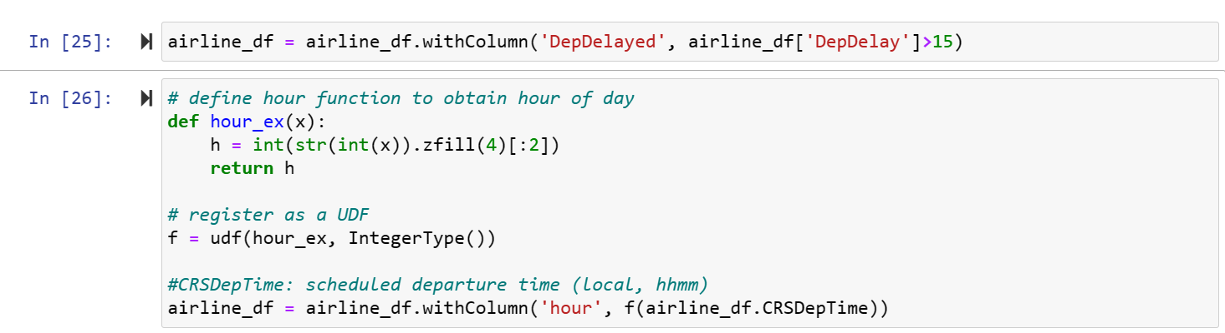
Feature Engineering

Slide 16
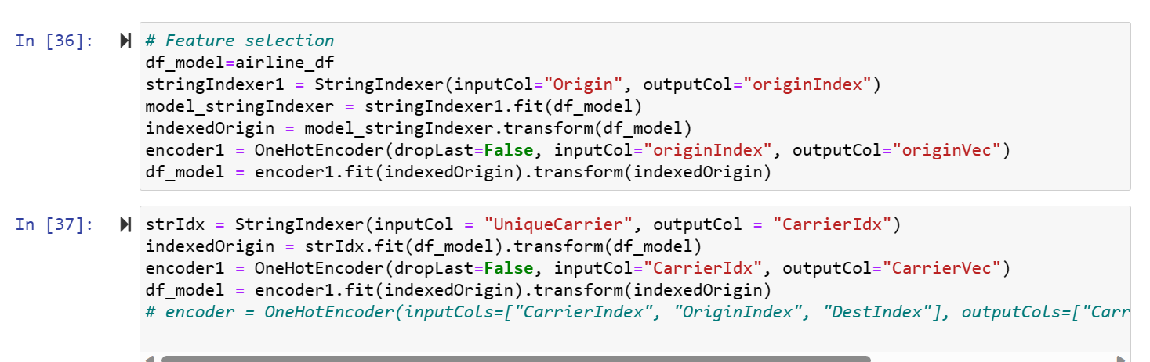
Logistic Regression

Slide 17
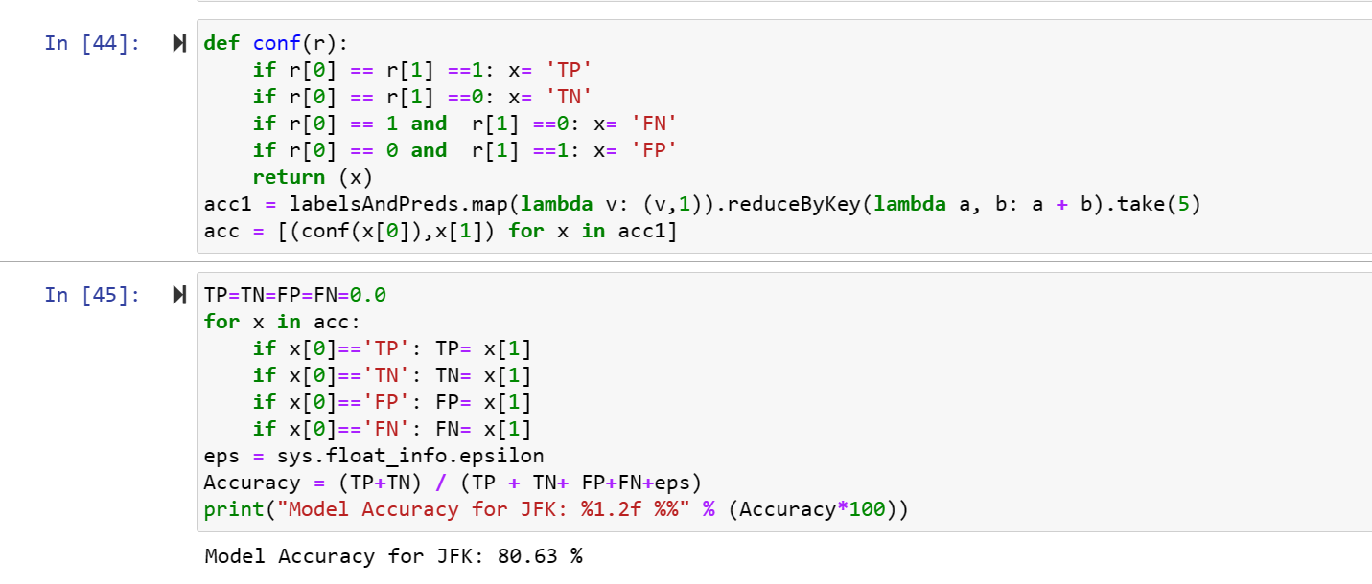
Logistic Regression

Slide 18
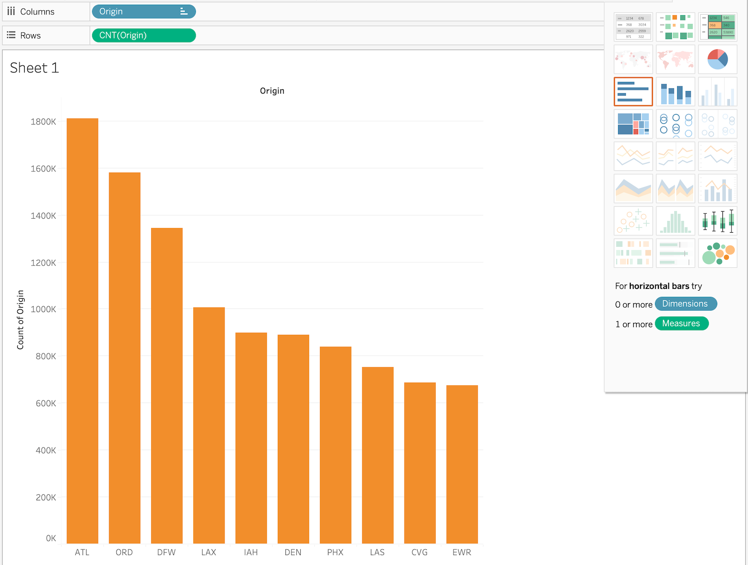
Tableau Visualization
Top 10 Busiest airports
Plotted a graph on top 10 origins with highest flight counts
ATL had the highest flight arrivals.

Slide 19
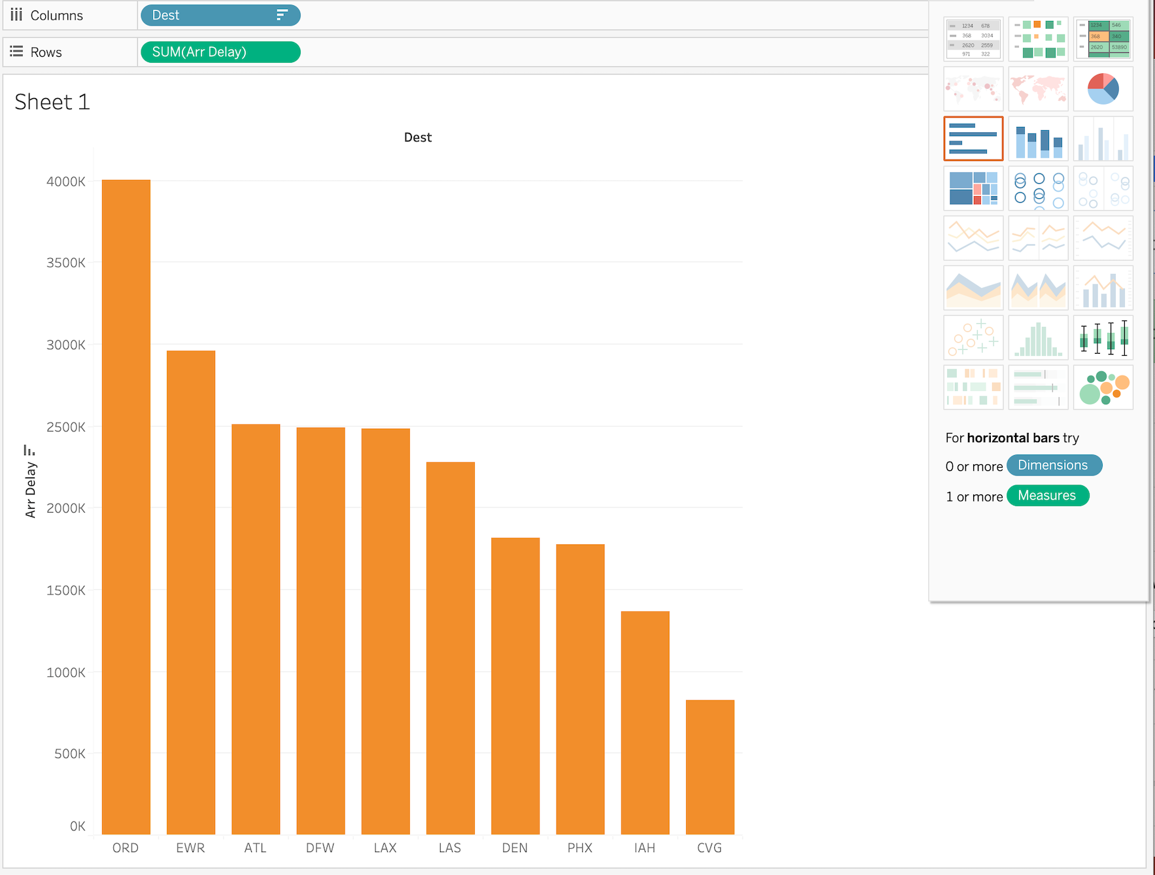
Top 10 Arrival delay destinations
Plotted a graph on top 10 airports that are experiencing arrival delays from 2004 to 2008
We can say that ORD airport had total highest arrival delays so far.

Slide 20
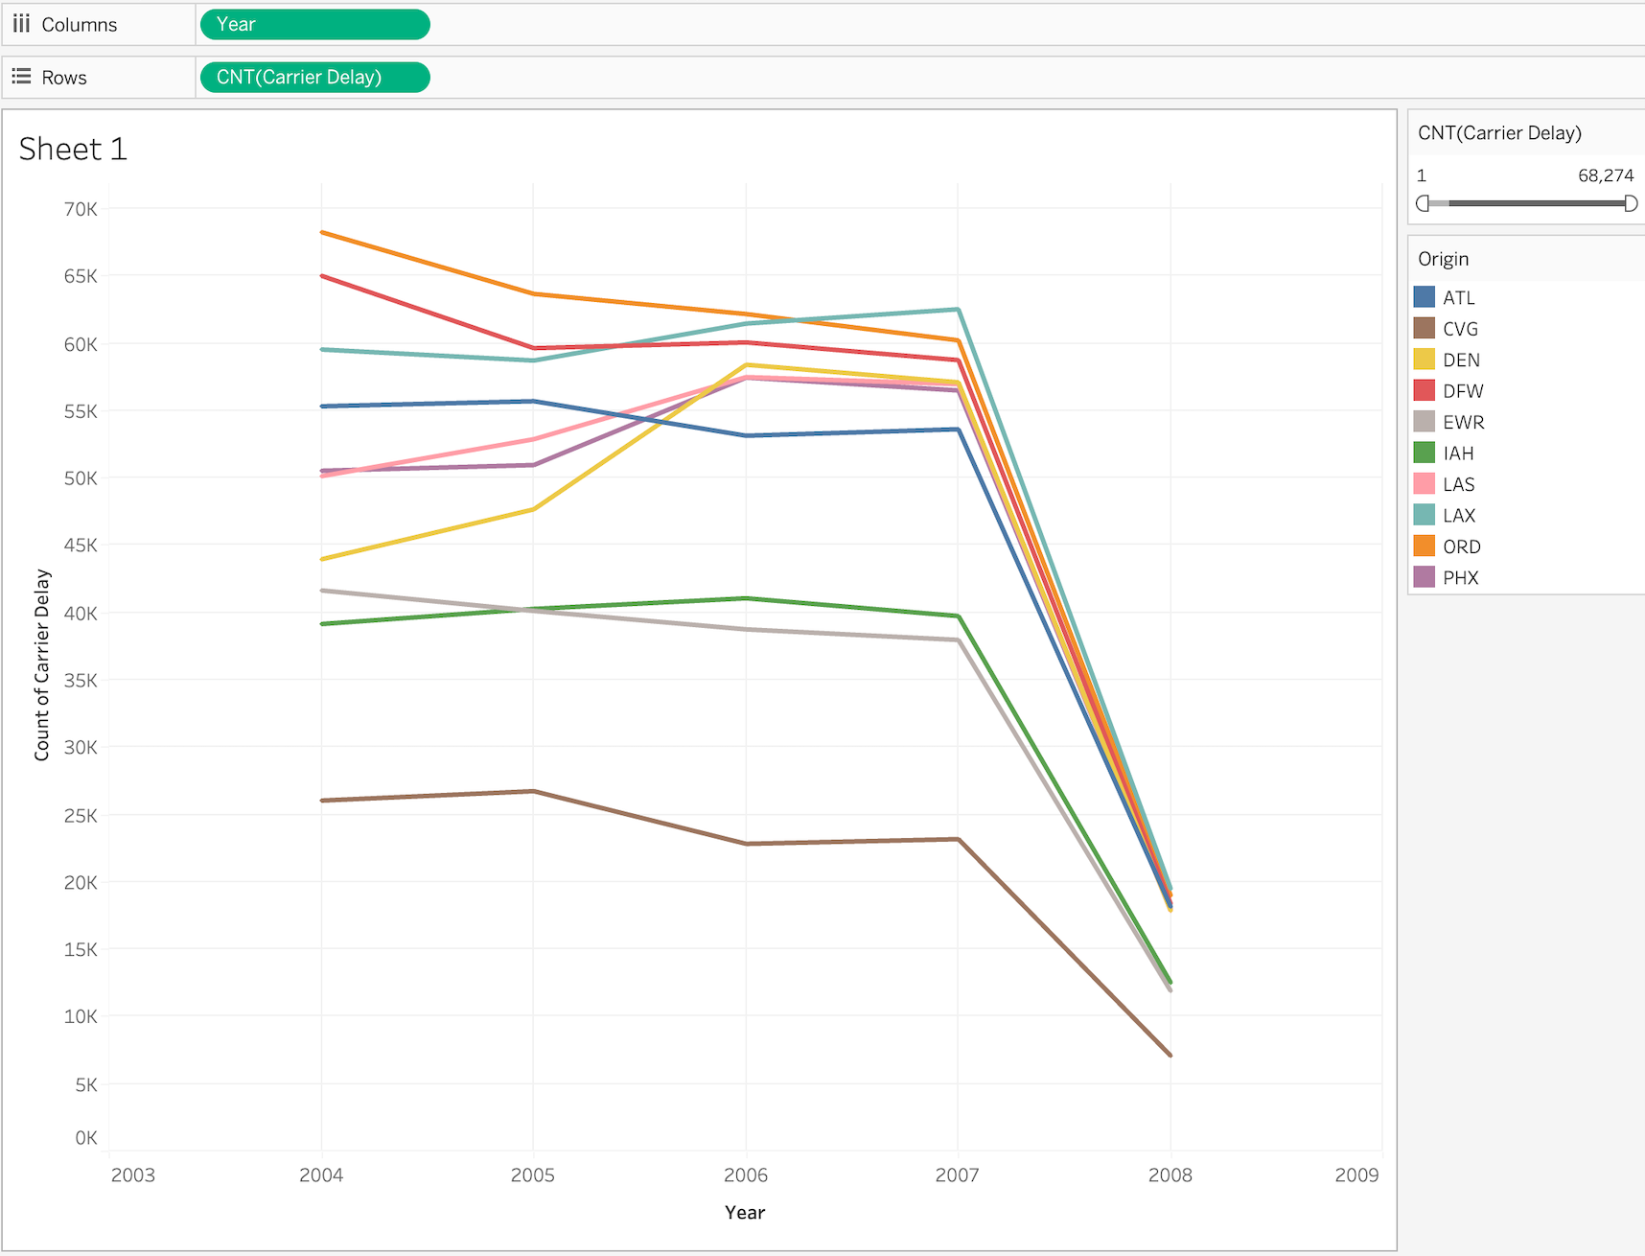
Carrier Count of flights over the years
From the graph, we can say that the carrier delays experienced a slight fluctuation from 2004 to 2008.

Slide 21
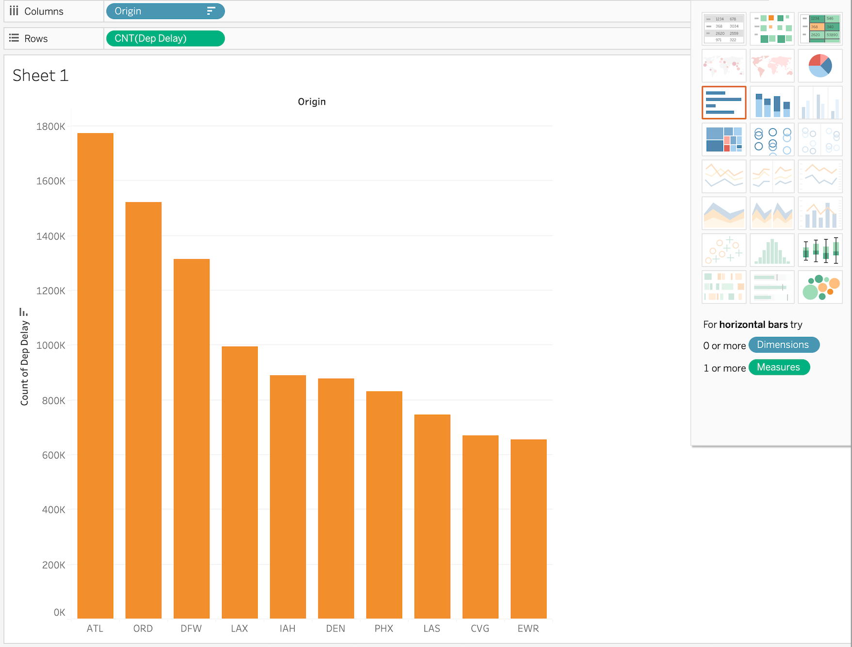
Airports with Most Departure delays
Plotted a graph on top 10 carriers that are experiencing departure delays from 2004 to 2008
We can say that ATL origin had more flights with departure delays

Slide 22
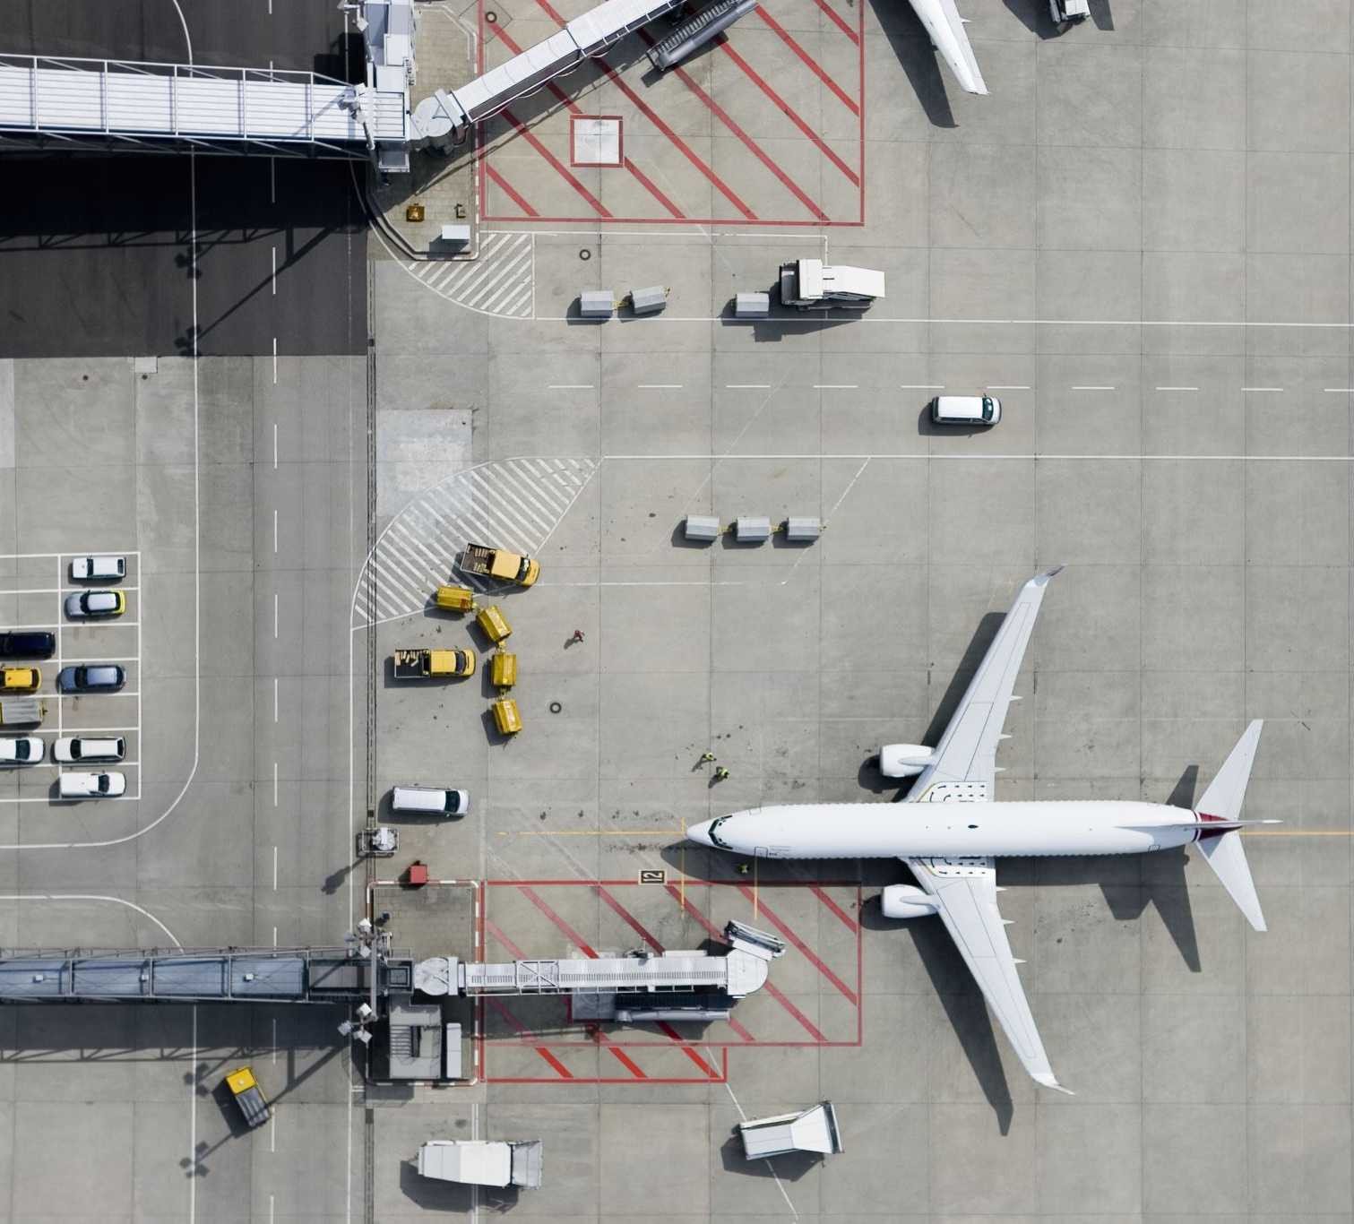
Conclusion and Learnings
We have analyzed that the Atlanta is in top place with highest flight arrivals and departures from 2004 to 2008.
Majority of the delays are due to LateAirCraft Delay and Security Delay is least observed.
Chicago O'Hare International(ORD) Airport had the highest Arrival Delays.
Southwest(WN) carrier had the highest flight count from 2004 to 2008.
Built a machine learning model using Logistic Regression and achieved an accuracy of 80.6%.
Combining flight delay data with other data sources, such as weather or traffic data, can provide a more complete understanding of the factors that contribute to delays.

Slide 23
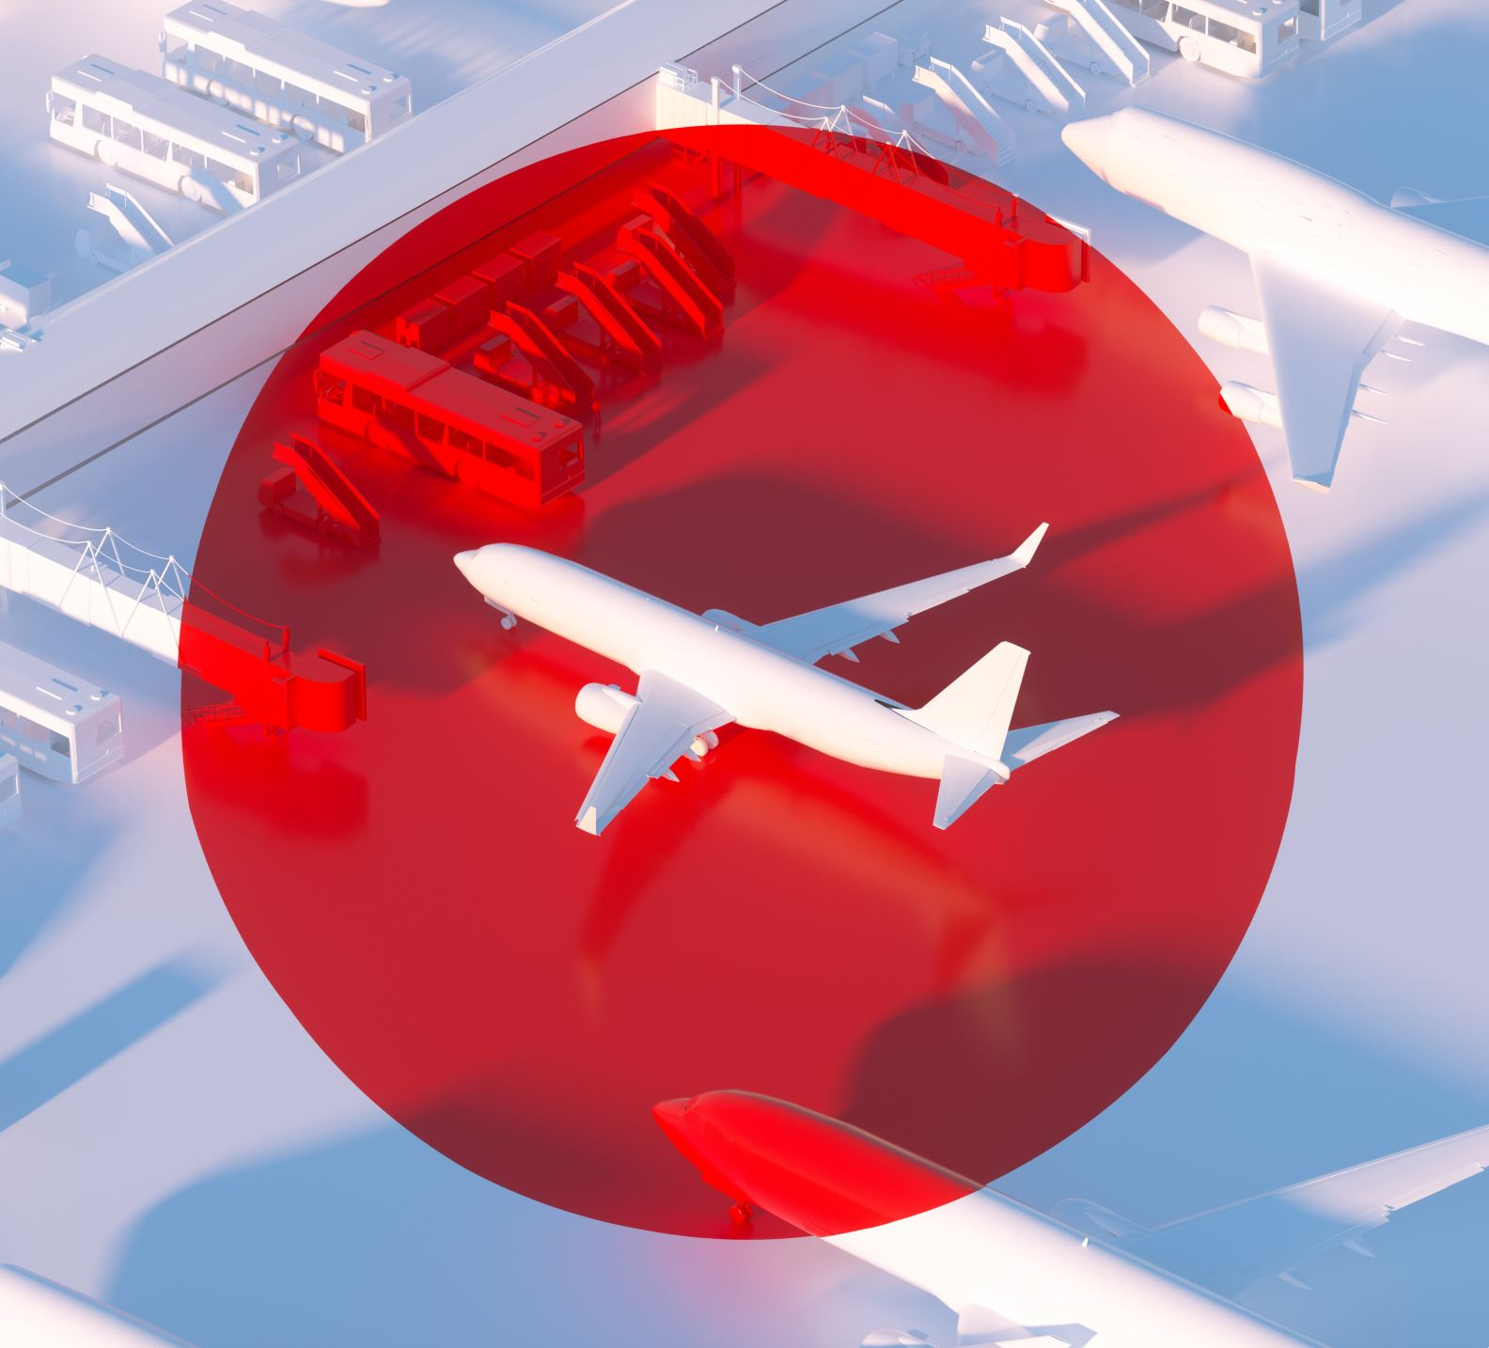
Implementation Improvements
Building a model with 10 years data.
Origin Airport specific delay prediction and recommendations.
Code to be run in cluster for performance optimization.
Flight delay data can be used to optimize flight schedules, provide customer insights, and be combined with other external data sources to improve decision-making.

Slide 24

Thank you

